Slide 1
논문리딩 3조
김지혜 김마린 박민주 전혜린

Slide 2
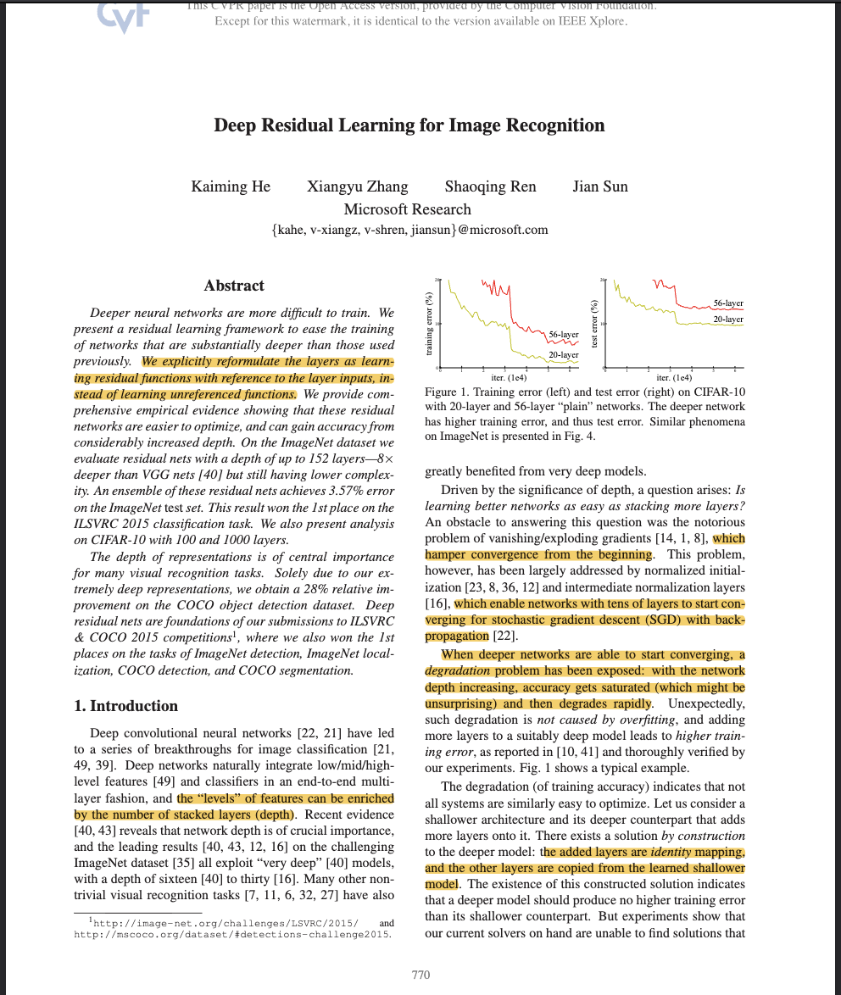
[Deep Residual Learning for Image Recognition CVPR 2016]
Solution for Degradation Problem

Slide 3
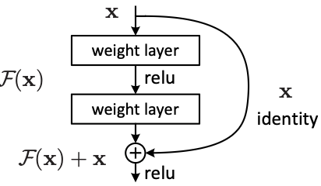
[Main Idea For Degradation Problem]
[Learning Residually]
F(x) = H(x) – x
Output = F(x) + x

Slide 4
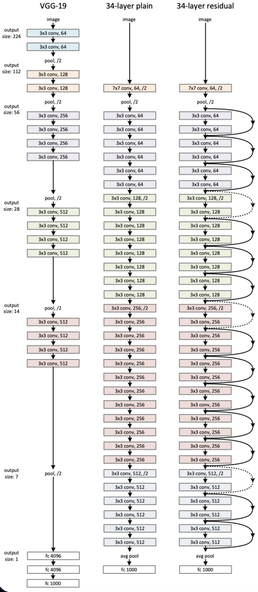

Slide 5
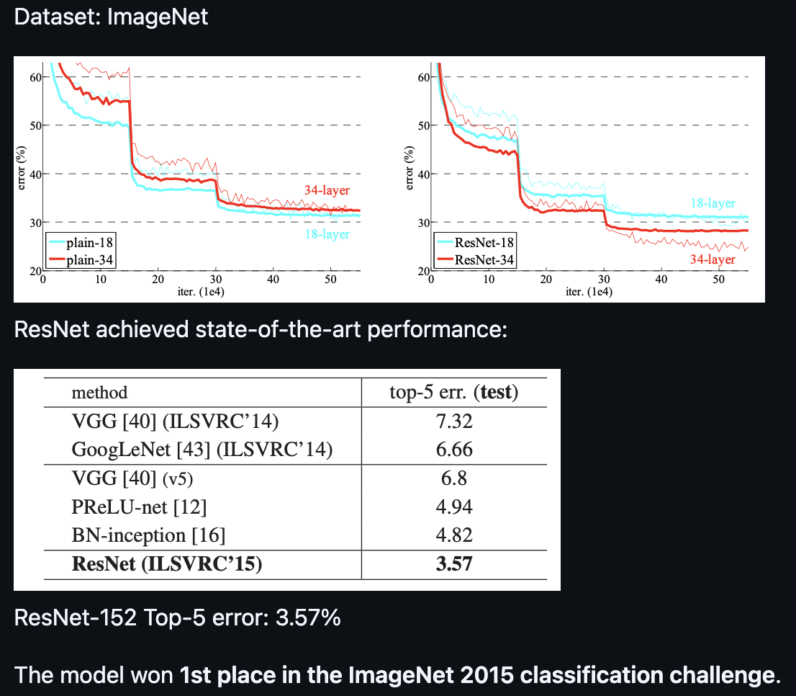
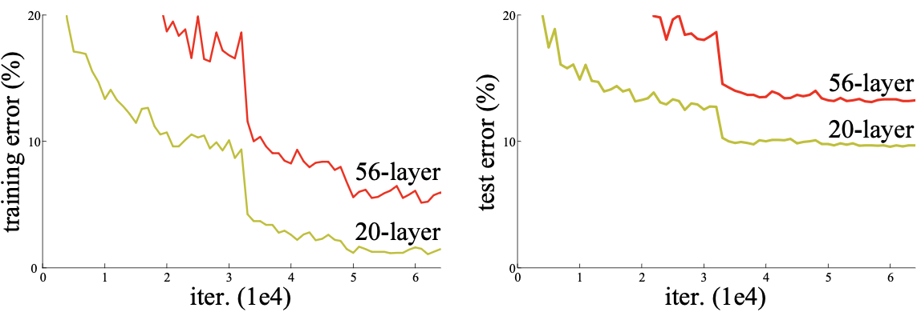
[Result]

Slide 6
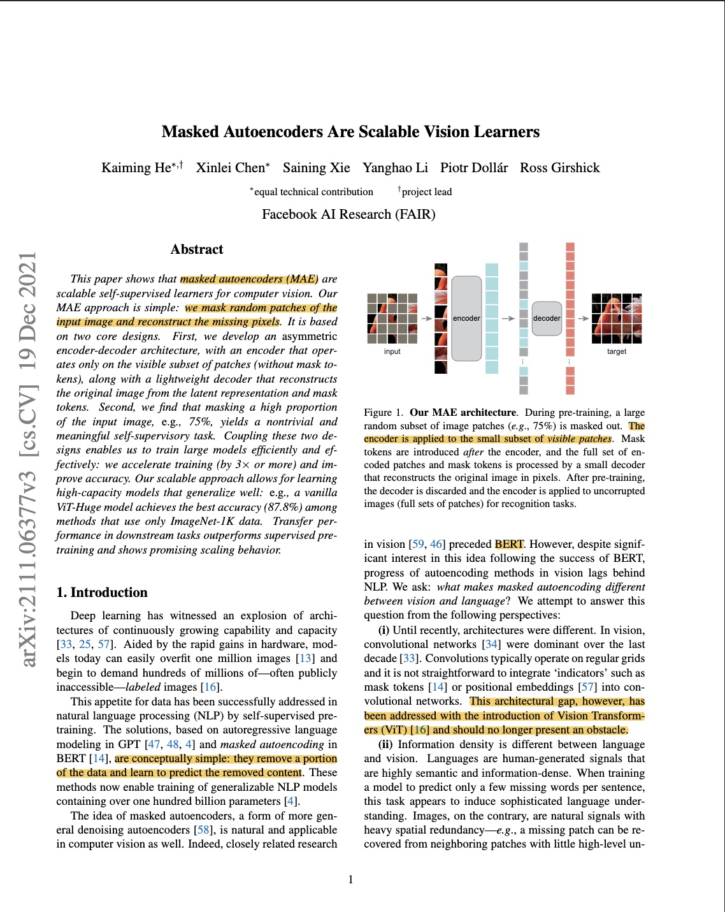
[Masked Autoencoders Are Scalable Vision Learners]
NLP -> BERT Model = Masked Autoencoder Method
= Transformer Model
>> Born to be fit in NLP
Let’s use Transformer Model in CV

Slide 7
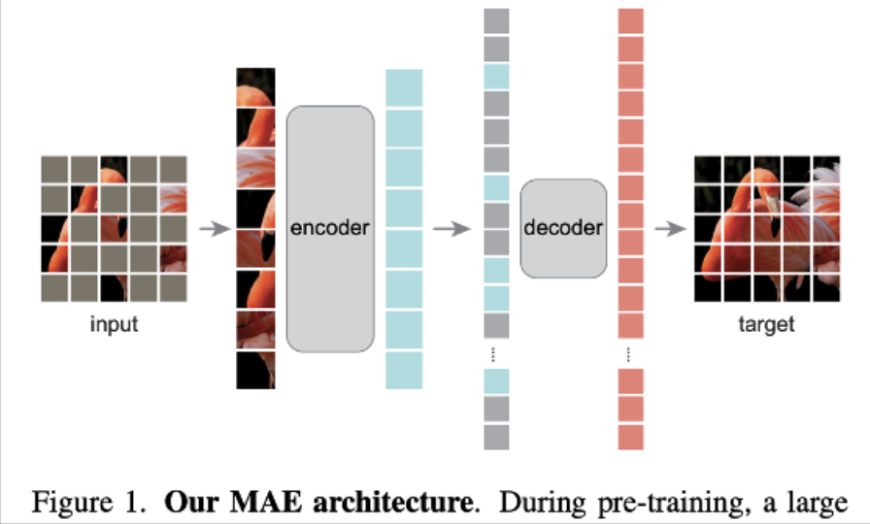
[Main Idea Of MAE]
>>By Masking a High Portion
Difference between Language and Image

Slide 8
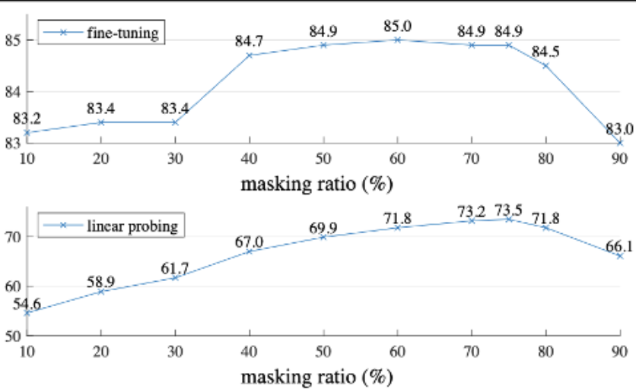
[Result]
BERT = 15%
MAE for CV = 84.9%
Difference between Language and Image

Slide 9
[Plans for 5-7weeks]
Implement and verify paper findings (e.g., test whether 75% masking in MAE actually produces the best accuracy)
Read Diffusion Model paper
Apply to project (e.g., ResNet vs ViT performance comparison)

